Slide 1
Call Center Simulation using NS3
Project Advisor:
Dr. Tariq Mahmood Jadoon
Ammarah Azmat Hira Tariq
Muhammad Shamaas Zarmeen Khan

Slide 2
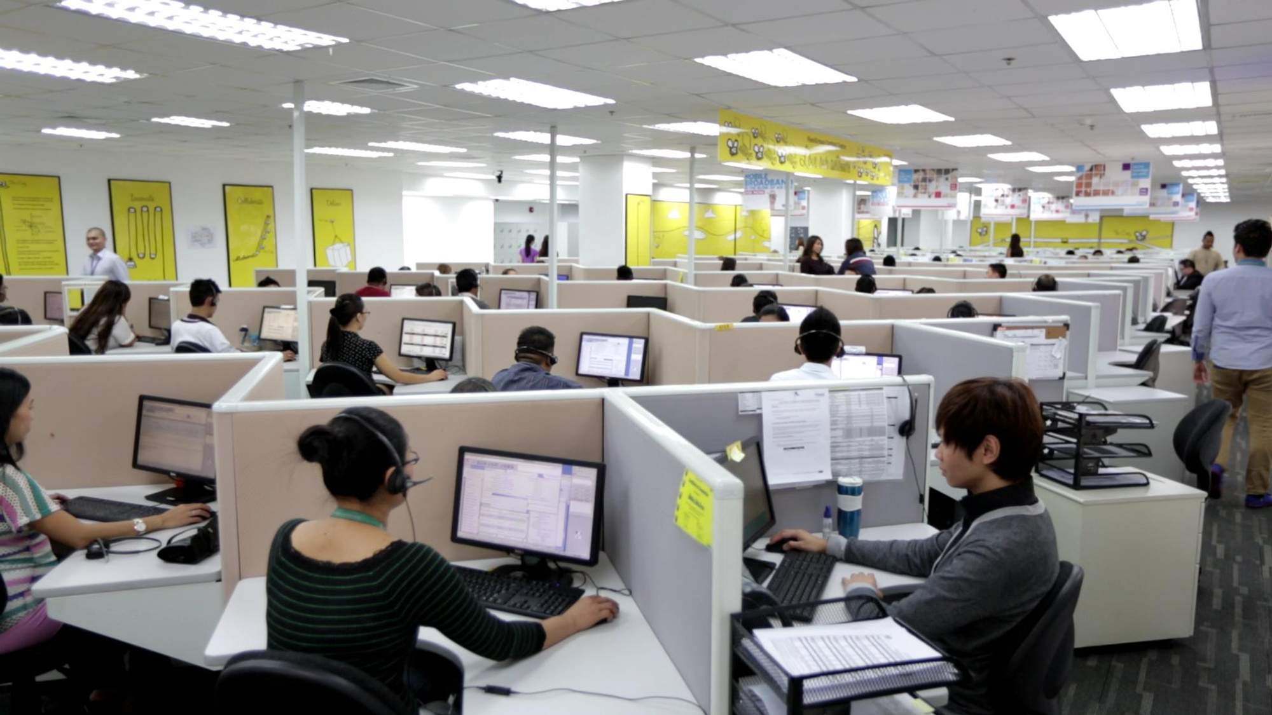
Call Center Queuing Model

Slide 3
Overview
NS3 is a Discrete Event Simulator.
Erlang C which assumes that traffic is light and callers do not abandon the Queue before Service (Keshav 2007). We compared experimental results for mean waiting time in Queue with Ger Koole calculator (Koole 2007).
We verified a more complex and realistic call center model called Erlang X. It incorporates Queue abandonments of callers, heavy call traffic, call drops and skill based routing (Iversen 2001).
We modified simulator to verify results of a real call center.

Slide 4
Call Centers
Call center is a centralized office used for receiving a large volume of requests by telephone (Perros 2009, Iversen 2001).
The callers are serviced by a group of call center agents trained for customer management (Robbins 2015).
Callers are distributed to idle agents by Automatic Call Distributor ACD which controls circuit switches in call center (Gans et al. 2003).
If all agents are busy in service, callers have to wait their turn in a Queue because all circuit switches are unavailable.
Callers can abandon Queue if their patience runs out.

Slide 5
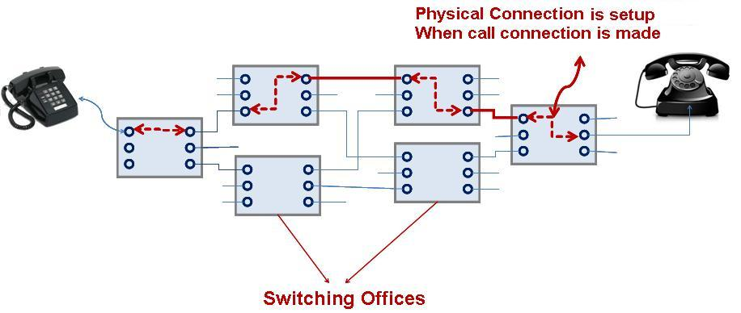
Simulating inherent Circuit Switched model as Packet Switched in NS3.

Slide 6
Part 1
Erlang C Model

Slide 7
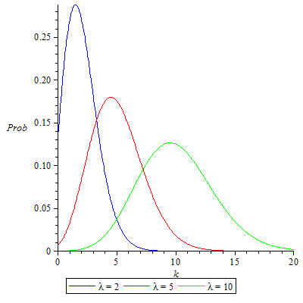
Erlang C
IP Packets denote calls.
A caller generates IP Packets of variable length to represent duration of call.
Calls arrive to a Poisson distribution: inter-arrival times are independent and identically distributed with negative exponential distribution. All Calls have same Call Duration distribution.
A distributor queues the packets and forwards them to idle agents.
The agent remains busy for a time period equal to the length of the packet and then becomes idle again. All agents are homogenous.
Calls are not dropped.
Callers do not abandon queue.

Slide 8
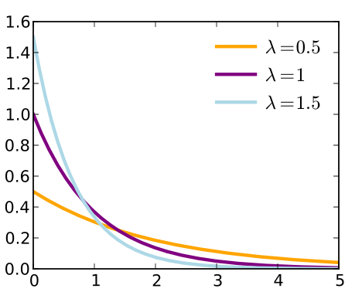
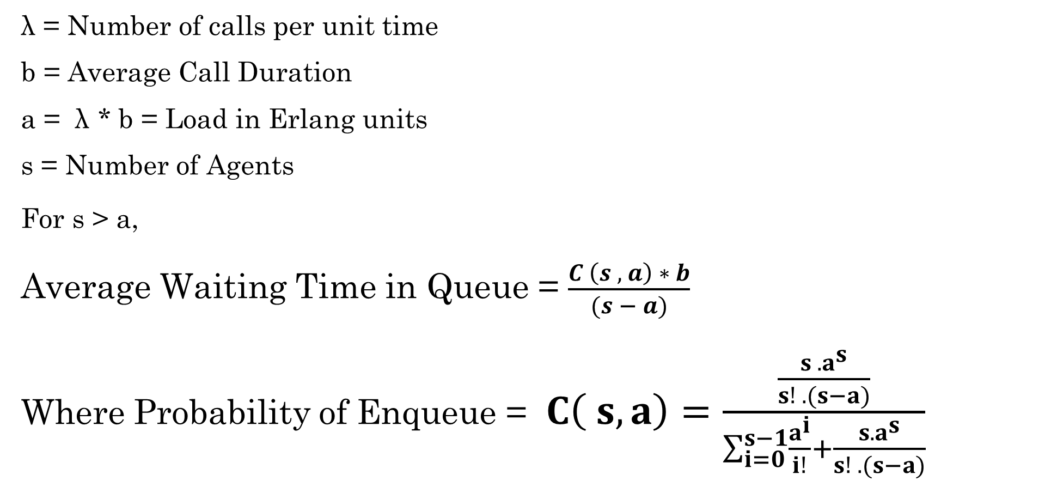
Erlang C Formula
λ = Number of calls per unit time
b = Average Call Duration
a = λ * b = Load in Erlang units
s = Number of Agents
For s > a,
Average Waiting Time in Queue = $\frac{C \left(s , a\right) ∗ b}{(s − a)}$
Where Probability of Enqueue = $C\left( s, a\right)=\frac{\frac{{s . a}^{s}}{s! . (s−a)}}{\sum_{i=0}^{s−1}{\frac{a^{i}}{i!}}+\frac{s.a^{s}}{s! . (s−a)}}$
Average Waiting Time in Queue
Number of Agents

Slide 9



Strategy
Receiver and Distributor Node
Agent Node 1
Caller Node
Point To Point Link
Point To Point Link
Virtual Response Unit
Agent Node 2
Queue
Point To Point Link

Slide 10
Queue
Tail Link
Link 2
Link 1
Head Link
Front Pointer
Front Pointer
Front Pointer
Front Pointer
ENQUEUE
DEQUEUE
IP Packet
IP Packet
IP Packet
IP Packet
IP Packet
IP Packet

Slide 11
Caller Node Application
Start
Idle
Generate Random Number for Packet Size
Schedule Next Call (Negative Exponential Distribution)
Make and Send Packet to Distributor Node

Slide 12
Distributor Node Application
Start
Idle
Check if Queue has a Packet
Packet Received
Enqueue Packet
Schedule Next Check
Dequeue and Send Packet if Agent is Idle

Slide 13
Agent Node Application
Start
Idle
Packet Received
Wait for Time equal to Packet Size
Busy

Slide 14
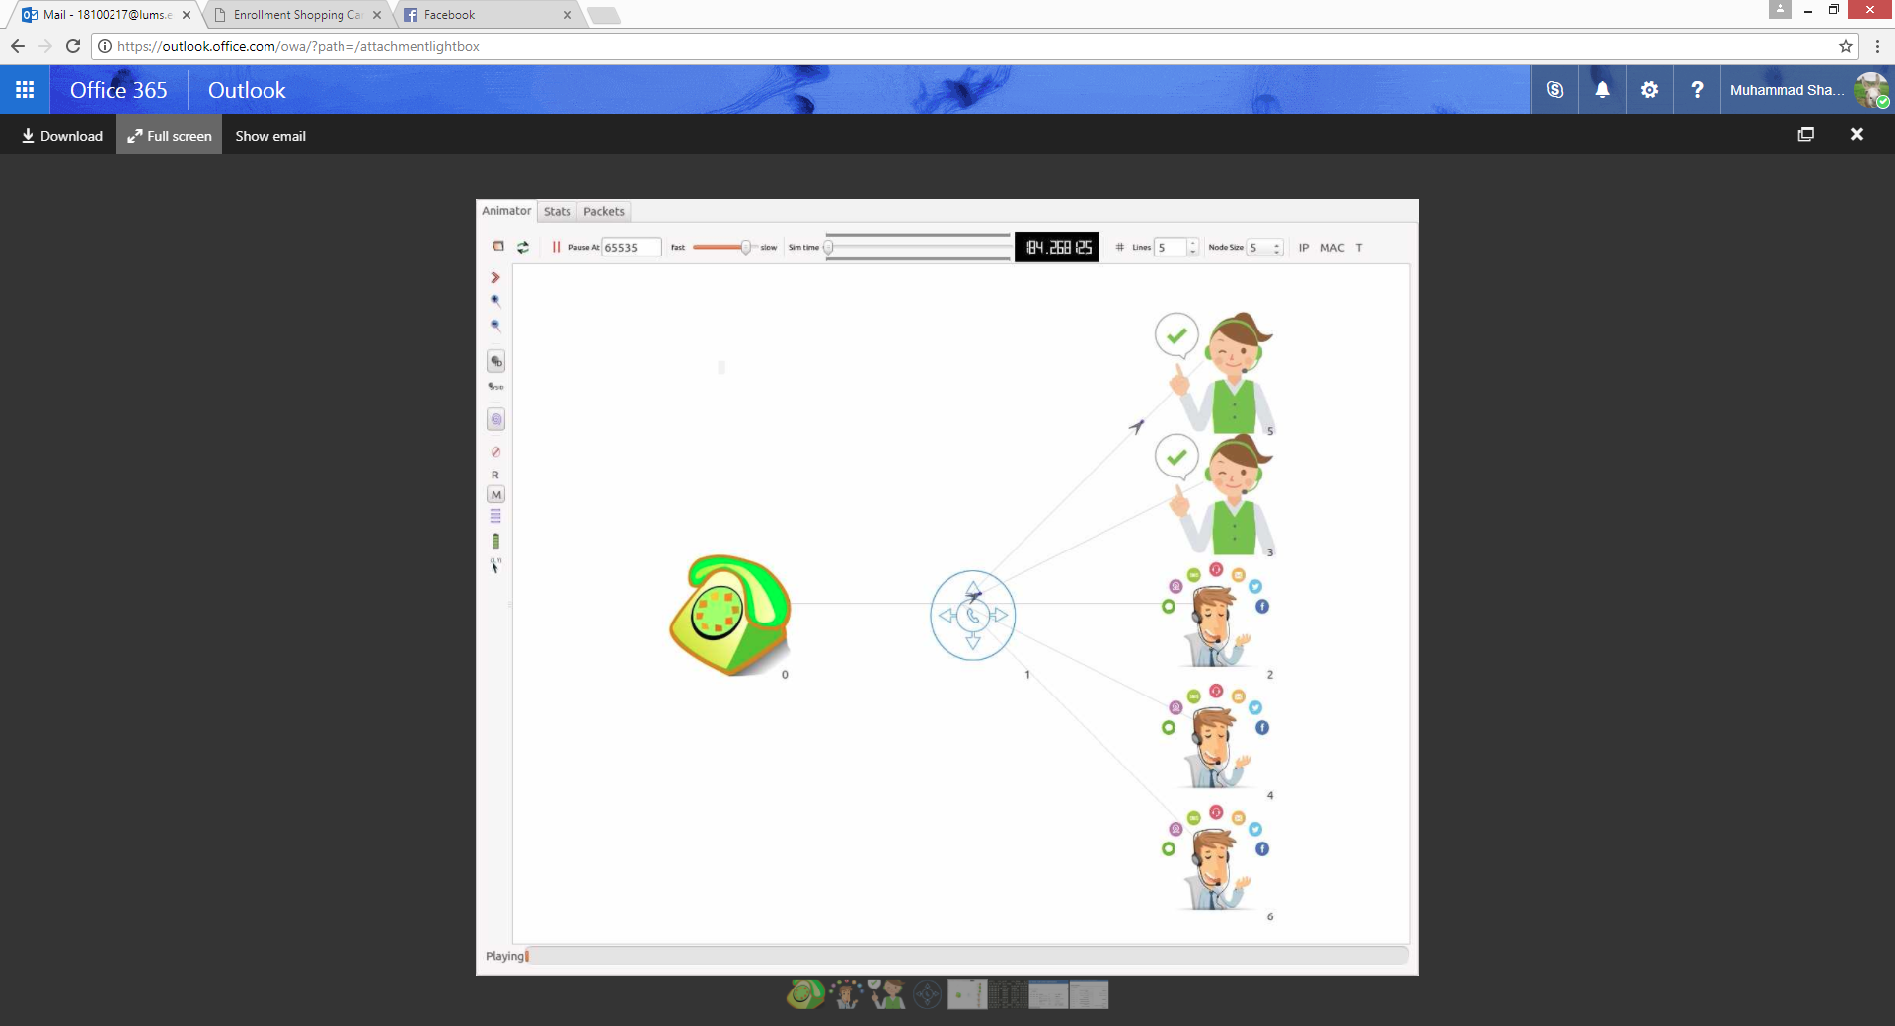
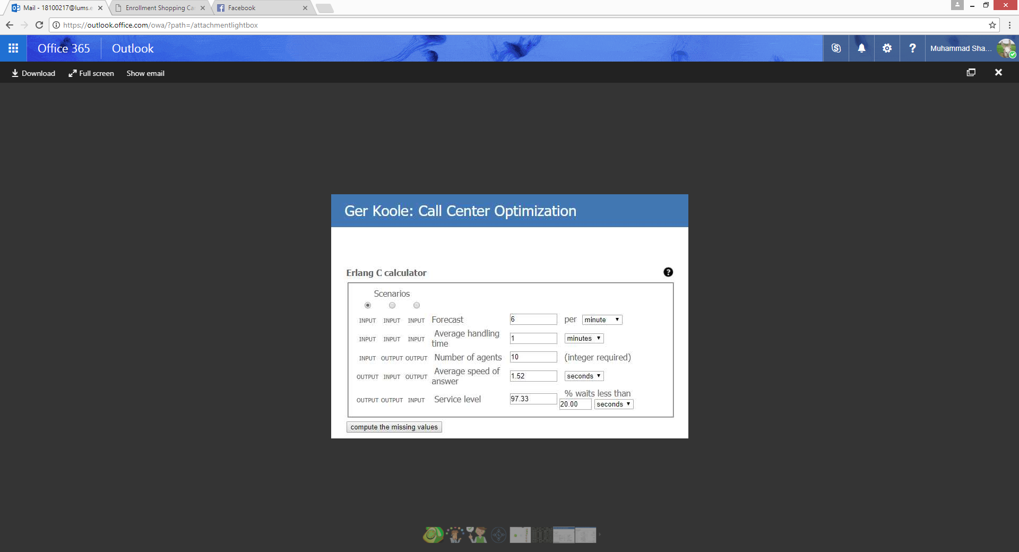
Simulator and Online Calculator

Slide 15
Simulation Results
Number of Agents | Mean Call Duration | Mean Inter-Arrival Time | Average Waiting Time (Simulation) | Standard Deviation | 90% Confidence Interval | Average Waiting Time (Erlang C Formula)
4 | 50.978 | 15.511 | 44.272 | 5.7407 | [41.1349, 47.4093] | 45.450
5 | 50.322 | 15.668 | 7.8829 | 1.1426 | [7.2585, 8.5073] | 8.2108
6 | 50.583 | 15.477 | 2.4085 | 0.2988 | [2.2452, 2.5718] | 2.5495
7 | 50.105 | 15.539 | 0.6374 | 0.1835 | [0.5371, 0.7377] | 0.6990
8 | 50.469 | 15.628 | 0.1540 | 0.1097 | [0.0941, 0.2139] | 0.2056

Slide 16
Results

Slide 17
Part 2
Erlang X Model

Slide 18
Erlang X
Queue abandonment…Erlang A.
Packets can be dropped.
Generalists, Specialists.
Calls can require multiple skills.
All Calls have same Call Duration distribution.

Slide 19
IP Packet
Patience counter 200
Source Address
Skill (TOS Tag) 0b1010
Destination Address
Packet Size 50

Slide 20
Queue with Maximum Size 20
Tail Link
Link 2
Link 1
Head Link
Front Pointer
Front Pointer
Front Pointer
Front Pointer
DEQUEUE
ENQUEUE
Enqueue
IP Packet
IP Packet
IP Packet
IP Packet
IP Packet
IP Packet
Skill 1
Skill 3
Skill 1
Skill 3
Patience 25
Patience 15
Patience 0
Patience 5

Slide 21
Queue
Tail Link
Link 2
Link 1
Head Link
Front Pointer
Front Pointer
Front Pointer
To Agent
ENQUEUE
Enqueue
IP Packet
IP Packet
IP Packet
IP Packet
IP Packet
IP Packet
Skill 1
Skill 3
Skill 1
Skill 3
Patience 25
Patience 15
Patience 0
Patience 5
Abandonment
IP Packet

Slide 22
Strategy
Enqueue packets if queue is not full.
Compare skill to the idle operator.
Meanwhile decrement patience counter.
One packet cannot block the entire queue.

Slide 23
Skill(s)
Packet Skill = 0b0010
Agent Skill = 0b1010
Bitwise AND = 0b0010
Agent can service this packet.
Packet Skill = 0b1100
Agent Skill = 0b1010
Bitwise AND = 0b1000
Agent can not service this packet.

Slide 24
Caller Node Application
Start
Idle
Generate IP packet of random Size, Patience value and Skill
Schedule Next Call (Negative Exponential Distribution)
Make and Send Packet to Distributor Node

Slide 25
Distributor Node Application
Start
Idle
Decrement Patience Counter every second and Remove Link if Counter is zero
Check if Queue has a Packet
Packet Received
Drop Packet if Queue is full
Enqueue Packet
Schedule Next Check
Dequeue and Send Packet if Agent is Idle and Skill Matches

Slide 26
Agent Node Application
Start
Idle
Packet Received
Wait for Time equal to Packet Size
Busy

Slide 27
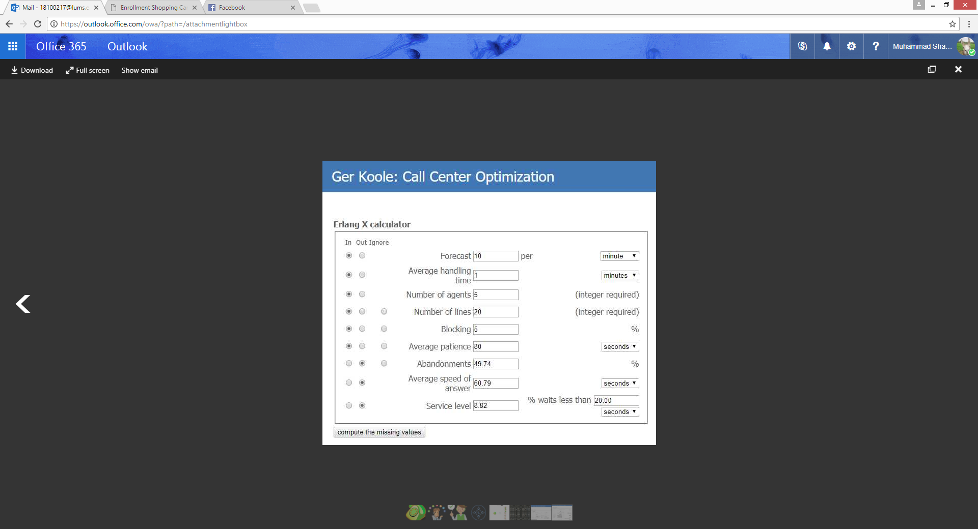
Simulator and Online Calculator

Slide 28
Simulation Results
Number of Agents | Arrivals per minute | Mean Call Length | Average Patience | Abandonments Percentage | Mean Waiting Time (Erlang X Simulation) | 99% Confidence Interval | Mean Waiting Time (Erlang X Formula)
7 | 10.844 | 50.364 | 200.37 | 27.506 | 38.454 | [36.9980, 39.9094] | 55.87
8 | 10.873 | 50.673 | 201.70 | 19.537 | 26.982 | [26.3361, 27.6283] | 36.57
9 | 10.849 | 50.704 | 202.81 | 14.845 | 19.822 | [18.3754, 21.2692] | 21.56
10 | 10.939 | 50.794 | 201.45 | 9.2483 | 12.649 | [11.4348, 13.8612] | 12.65
11 | 10.980 | 50.433 | 200.75 | 5.2236 | 7.1655 | [5.9945, 8.3365] | 6.68
12 | 10.793 | 50.784 | 200.50 | 2.8851 | 3.7695 | [3.0709, 4.4681] | 3.31
13 | 10.966 | 50.075 | 199.48 | 1.5449 | 2.1767 | [1.4433, 2.9101] | 1.68

Slide 30
Part 3
Real Call Center Model

Slide 31
Real Call Center
Arrival rates are different at different times of day.
Callers must Specify their required skill using Virtual Response Unit VRU.
Callers can abandon Queue after waiting for some time.
Callers can Hang up at any time.
Agents have inhomogeneous service time distributions.
Agents can have six skills. Specialists have only one skill. Generalists can have two or more skills.
Agents are scheduled depending on Traffic Intensity.

Slide 32
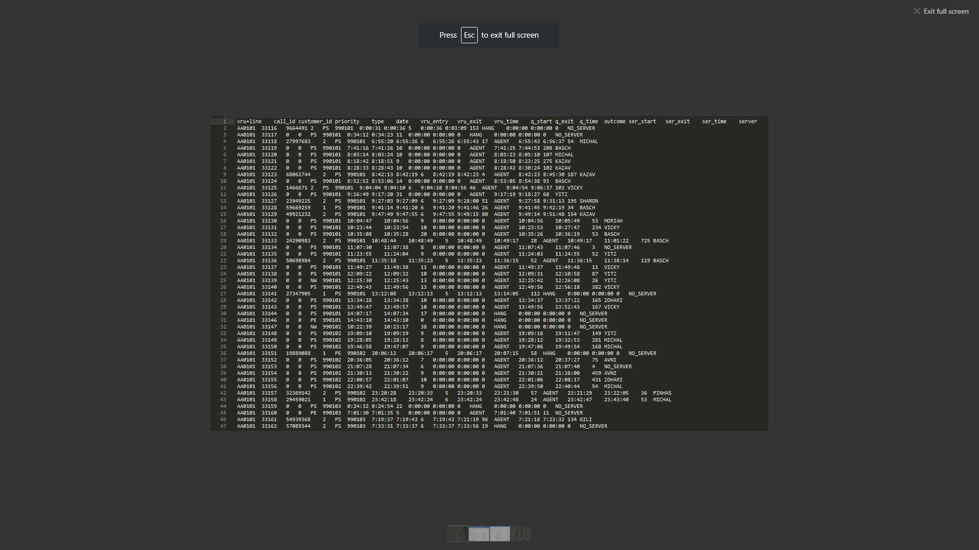
Real Call Center Records (Mandelbaum 2002)
Fields: vru line : call id : customer id : priority : type : date : vru time : q time : outcome : ser time : server

Slide 33
Call Center Data

Slide 34
Profiles of Agents
Agent | Total Answer Time (Hrs.) | Total Calls Answered | Average Service Time (s) | Skills (PE,IN,TT,NE,NW,PS)
GILI | 4.032 | 111 | 130 | 001101
SHARON | 5.734 | 154 | 134 | 001111
TALI | 3.571 | 63 | 204 | 101011
YITZ | 5.406 | 116 | 167 | 001011
ANVI | 5.748 | 69 | 299 | 000111
YIFAT | 4.356 | 98 | 160 | 110001
LORI | 5.700 | 76 | 270 | 010011
TOVA | 5.318 | 129 | 148 | 100111
KAZAV | 5.646 | 133 | 152 | 001111
ELI | 3.087 | 21 | 529 | 000100
MICHAL | 4.278 | 91 | 169 | 100011
ZOHARI | 2.302 | 25 | 331 | 000101
MIKI | 4.614 | 113 | 146 | 101011
NAAMA | 4.429 | 112 | 142 | 001101
ANAT | 4.281 | 82 | 187 | 010111
IDIT | 4.386 | 131 | 120 | 101011
DORIT | 3.574 | 63 | 204 | 001001
SHLOMO | 1.592 | 56 | 102 | 010011
BENSION | 3.308 | 70 | 170 | 010011
GELBER | 1.577 | 39 | 145 | 001011
MORIAH | 4.601 | 89 | 186 | 100111
PINHAS | 0.668 | 10 | 240 | 000011
Total | 88.208 | 1491

Slide 35
Strategy
Make a primary VRU queue that comes before Callers Queue.
Add a VRU counter in each packet.
Decrement VRU Counter of each Link after every second. If VRU Timer is zero, remove Link from VRU Queue and Enqueue in Callers Queue.
Before Enqueue, check if queue is full. If queue is full, drop packet.
If patience of a caller runs out remove it from Caller’s Queue.
Keep a Skill section in each Link to aid distribution of packets to operators.
Each Agent will have it’s own distribution of service times and skills.

Slide 36
IP Packet
Patience counter 200
Skill (TOS Tag) 0b1010
Source Address
Destination Address
Packet Size 50
VRU Counter 50

Slide 37
Virtual Response Unit Linked List
Tail Link
Link 2
Link 1
Head Link
Front Pointer
Front Pointer
Front Pointer
Front Pointer
ENQUEUE
Enqueue
IP Packet
IP Packet
IP Packet
IP Packet
IP Packet
VRU Counter 9
VRU Counter 5
VRU Counter 0
VRU Counter 4

Slide 38
Virtual Response Unit Linked List
Tail Link
Link 2
Link 1
Head Link
Front Pointer
Front Pointer
Front Pointer
ENQUEUE
Enqueue
IP Packet
IP Packet
IP Packet
IP Packet
IP Packet
VRU Counter 9
VRU Counter 5
VRU Counter 0
VRU Counter 4
ENQUEUE in Callers Queue
IP Packet

Slide 39
Callers Queue
Tail Link
Link 2
Link 1
Head Link
ENQUEUE from VRU Unit
Front Pointer
Front Pointer
Front Pointer
Front Pointer
DEQUEUE
Enqueue
IP Packet
IP Packet
IP Packet
IP Packet
IP Packet
IP Packet
Skill 1
Skill 3
Skill 1
Skill 3
Patience 25
Patience 15
Patience 0
Patience 5

Slide 40
Queue Abandonments
Tail Link
Link 2
Link 1
Head Link
Front Pointer
Front Pointer
Front Pointer
DEQUEUE
ENQUEUE
Enqueue
IP Packet
IP Packet
IP Packet
IP Packet
IP Packet
IP Packet
Skill 1
Skill 3
Skill 1
Skill 3
Patience 25
Patience 15
Patience 0
Patience 5
Abandonment
IP Packet

Slide 41
Caller Node Application
Start
Idle
Generate Random Number for Packet Size, Patience, VRU Time and Skill
Schedule Next Call (Negative Exponential Distribution)
Make and Send Packet to Distributor Node

Slide 42
Distributor Node Application
Start
Idle
Decrement Patience Counter every second and Remove Link if Counter is zero
Check if Queue has a Packet
Packet Received
Drop Packet if Queue is full
Enqueue Packet after VRU
Schedule Next Check
Dequeue and Send Packet if Agent is Idle and Skill Matches

Slide 43
Agent Node Application
Start
Check Agent Schedule
Idle
Generate Random Number for Service Time and Wait for that duration
Packet Received
Out of Service
Busy

Slide 44
Simulation Results

Slide 45
Simulation Results

Slide 46
Data Analysis
Service level of the call: it is the percentage of calls answered in less than specific time limit.
Total Problem Resolution: This was found by calculating the number calls resolved initially to those of the incoming calls that is the percentage of calls resolved in the first attempt.
Agent Salaries (hourly basis) depending on their performance
Net Promoter Score: this was calculated in response to every call, so was used to determine the performance of our call center system overall. Under this system every call received resulted in an increment in the NPS by 10, if dropped contributed nothing to it, if abandoned resulted in an increment by 10 and if was answered the NPS was further incremented by 10.​
Quality Scores: these were agent rating were done by analyzing and calculating the speed of answer of each agent and also the frequency of calls a specific agent answers in a given period of time.

Slide 47
Data Analysis
Profits: this was calculated by finding the ratio of the calls received in a given interval of time to the agent’s hourly salary.
Agents utilization (percentage of time the agents are busy)
Average Caller Time in System : sum of the queuing delay and the call time for each call.
Probability of wait : this was calculated by considering the arrival of calls when queue is not empty.
Traffic Intensity (Arrival rate / Service Rate)
Used the data above to determine relationship between the queue size and the time

Slide 48
Various Routing Schemes
Use different routing schemes according to the changing call arrival rate with respect to time
Fastest Server First (FSF) for high arrival rate.
Longest Idle First (LIF) for moderate arrival rate.
Lowest Cost Routing (LCR) low arrival rate.
Skill Based Routing (SBR).
Performance and quality can be improved through these routing schemes.

Slide 49
Fastest Server First (FSF)
Call servicing speed of all the agents are stored in the agent node.
Speed increases with experience.
When calls Arrival rate is high, calls are routed to the idle agents having high speed.
Queue waiting time will reduce.
More calls will be answered in lesser time.
Calls dropping rate will decrease.
Callers do not abandon queue.
Call Centre performance will increase

Slide 50
Longest Idle First (LIF)
Time since last service of all the agents are stored in the agent node.
It represents how long that agent has been idle.
When calls Arrival rate is moderate, calls are routed to the agents who are idle for long enough.
New agents will get experience.
Speed of new agents will also increase.

Slide 51
Lowest Cost Routing (LCR)
Wages of the agents are known.
When calls Arrival rate is low, calls are routed to the idle agents having lowest wage.
Cost of paying the agents will reduce.
The Cost of running the call center will be optimized since expenses are minimized.

Slide 52
Comparing Routing Schemes
Routing Scheme | Abandonments Percentage | Net Promoter Score | Utilization of Agents | Quality Score | Probability of waiting | Calls Serviced | Total Wages
Longest Idle First Routing (Default) | 68.4105% | 1.59518 | 4.85981% | -549 | 18.7123% | 471/1491 | Rs.12183
Fastest Server First Routing | 5.96915% | 68.5756 | 14.4659% | 1313 | 22.1328% | 1402/1491 | Rs.33910
Skill Based Routing | 0.268276% | 71.8521 | 15.3430% | 1483 | 0.402414% | 1487/1491 | Rs.37489
Lowest Cost Routing | 0.201207% | 71.8891 | 15.3533% | 1485 | 0.201207% | 1488/1491 | Rs.37148

Slide 53
Routing Schemes

Slide 54
Relevance towards Solution to Societal Problems
Many other queue networks can be modeled using our simulator after a few modifications :
Shopping malls
Cash counters
Pick and drop services
Hospitals
Printer stations
Billing stations
Ticket booths
Banks
Industrial workforce management
Any queueing system with one or more servers that involves time and/ or resource management.

Slide 55
Timeline
Date | Objective
Sept 18 – Oct 2 | Verified Erlang C and Erlang X models.
Oct 2 - Oct 16 | Zarmeen Khan: Calculated call center performance metrics and plot Queue Size versus time. Hira Tariq: Introduced additional Call center agent performance measures that must be monitored. Ammarah Azmat: Sorting of Real Life Call Center Data. Muhammad Shamaas: Carried out Simulations, and study literature.
Oct 16 - Oct 30 | Zarmeen Khan: Completed Coding for plotting results of simulation and Automatic Voice Response Unit. Hira Tariq: Introduced Dynamic Call Routing Schemes and model Variable Delay for International Calls. Ammarah Azmat: Calculated performance metrics from Real Life Call Center Data. Muhammad Shamaas: Carried out Simulations and Dynamic Scheduling of Agents.
Oct 30 - Nov 13 | Simulated real life call traffic using call center records and calculate performance metrics for simulation.
Nov 13 - Nov 27 | Ammarah Azmat: Recorded simulation data Hira Tariq: Plotted simulation results Zarmeen Khan: Explained any mismatch between actual results and predictions of simulation model. Muhammad Shamaas: Prepared Design and Simulation Presentation
Dec 4 | Design and Simulation Group SPROJ-1 Presentation
January 1 | Submission of SPROJ-1 Design and Simulation Report after approval from Project Advisor

Slide 56
Review
We modeled a real life telephone call center using a packet switched network where duration of calls was equal to length of the packet. If no agents were idle, packets were stored in a Queue.
Erlang C: A basic call center model with no Caller Abandonments and light call traffic. Verified the Erlang C Formula by comparing analytical results with simulation results.
Erlang X: A more complex and realistic call center model with heavy call traffic, caller abandonments, call drops and skill based routing. We verified its results using Erlang X Calculator.
Real Call Center: We modified the simulator to match the results with a real call center by studying it’s call records and recording caller and agents distributions.

Slide 57
References
“Call Centre.” Wikipedia, Wikimedia Foundation, 17 Sept. 2017, en.wikipedia.org/wiki/Call_centre. Accessed Sept. 2017.
Call Clipart #4387, mzayat.com/single/4387.html.
“Erlang C Calculator.” Call Center Optimization, www.gerkoole.com/CCO/erlang-c.php. Accessed Sept. 2017.
“Erlang X Calculator.” Call Center Optimization, www.gerkoole.com/CCO/erlang-x.php. Accessed Sept. 2017.
Gans, Noah, et al. Telephone Call Centers: Tutorial, Review, and Research Prospects. 2nd ed., vol. 5, Amsterdam, Netherlands, 2003.
Iversen, Villy B. Teletraffic Engineering. Lyngby, Denmark, 2001.
Jerry, et al. Discrete-Event System Simulation. 4th ed., Prentice Hall.
Koole, Ger. Call Center Mathematics. Amsterdam, Netherlands, 2007.
Keshav, Srinivasan. Mathematical Foundations of Computer Networking. 2012.
Mandelbaum, A. Call Center Data. http://iew3.technion.ac.il/serveng/callcenterdata/index.html. 2002
Ns-3 Tutorial. 2017, www.nsnam.org/docs/release/3.26/tutorial/ns-3-tutorial.pdf. Accessed Sept. 2017.
Ns-3 Documentation, www.nsnam.org/docs/release/3.26/doxygen/index.html. Accessed Sept. 2017.
Perros, Harry. Computer Simulation Techniques: The definitive introduction! Raleigh, North Carolina, 2009.
Robbins, Thomas R. Experience-Based Routing in Call Center Environments. 2nd ed., vol. 7, Greenville, North Carolina, 2015.
Robbins, Thomas R., et al. Evaluating the Erlang C and Erlang A Models for Call Center Modeling Working Paper. Greenville, North Carolina.

